Slide 1

SSSC Awards Presentation 2025
The past three seasons of the Scimitar Sabre Speed Championship, we’ve celebrated the season and presented the awards at a Competitors online meeting.
On behalf of the Competitors, I wish to thank
the Score Masters Phil Howard and Jim King.
Sprint Coordinator Peter Smith, supported by Barry "Eagle eyed" Eccleston.
The Awards are for the:
Scratch Championship
Target-Time Championship
Compie Nominations

Slide 2
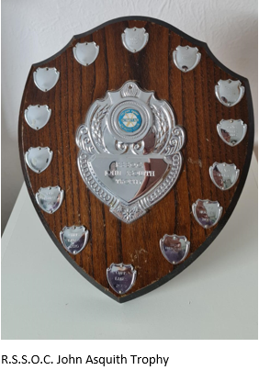

Scratch Award
RSSOC John Asquith Trophy
Highest scoring Competitor in the over 150 bhp Class. (but less than 250 bhp.)
Times at each event are compared to Scimitar or Sabre track records set since 2000. Points are calculated in accordance with the SSSC Regulation – section 1.6.
Winner: Jim King

Slide 3
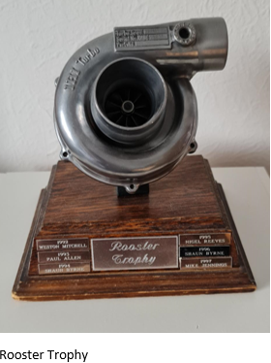
Scratch Award
The Robin Rew Rooster Trophy
Highest scoring Competitor in the under 150 bhp Class.
Times at each event are compared to Scimitar or Sabre track records set since 2000. Points are calculated in accordance with the SSSC Regulation – section 1.6.
Winner: Bryan Crouch

Slide 4

Target-Time Award
The RSSOC Trophy
1st Highest scoring Competitor in the Target-Time Championship.
Points calculated from the Competitor’s timed runs with their car’s target time factor applied, this is based on the certified power/weight ratio and the type of tyre used on the car. In accordance with the SSSC Regulation – section 1.6.
The RSSOC Trophy
1st Place Winner: Nigel Duffield

Slide 5
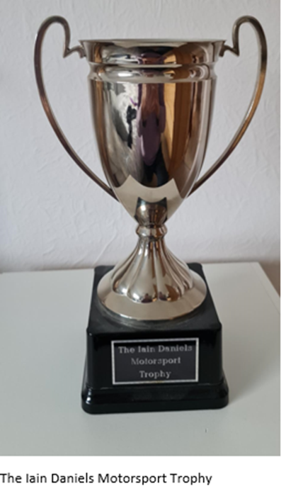
Target-Time Award
The Iain Daniels Motorsport Trophy
2nd Highest scoring Competitor in the Target-Time Championship.
Points calculated from the Competitor’s timed runs with their car’s target time factor applied, this is based on the certified power/weight ratio and the type of tyre used on the car. In accordance with the SSSC Regulation – section 1.6.
2nd Place Winner: Jim King

Slide 6
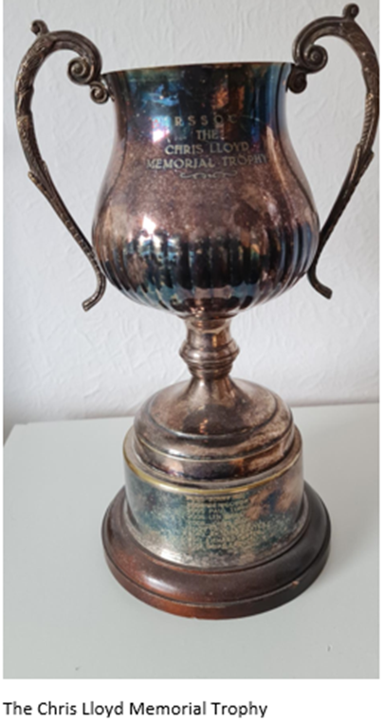
Special Award
The Chris Lloyd Memorial Trophy
This is a Competitors Nomination Award for the ‘Most Improved Driver or Notable Achievement’ competing in the SSS Championship
Winner: Dave Gallimore

Slide 7
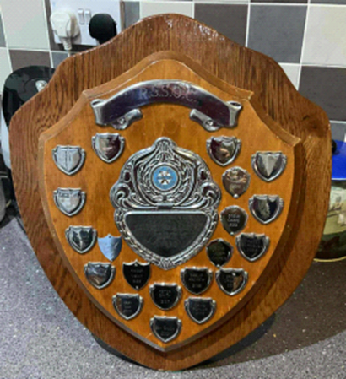
Special Award
The Valentine Walker Novice Award
This is a Competitors Nomination Award for the ‘Best Novice’ competing in the SSS Championship
Winner: Tom Cassia-Warrington
The Valentine Walker Novice Award

Slide 8
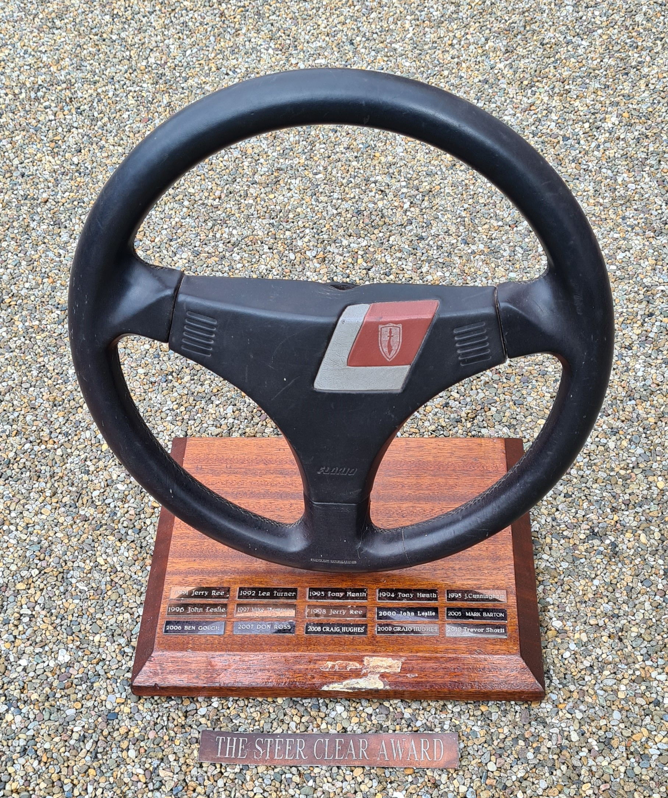
Other Awards
The Steer Clear Award
This is a Competitors Nomination Award for the ‘Biggest Off or Crash’ by a fellow competitor in the SSS Championship
Winner: Nick Keyser
Steer Clear Award

Slide 9
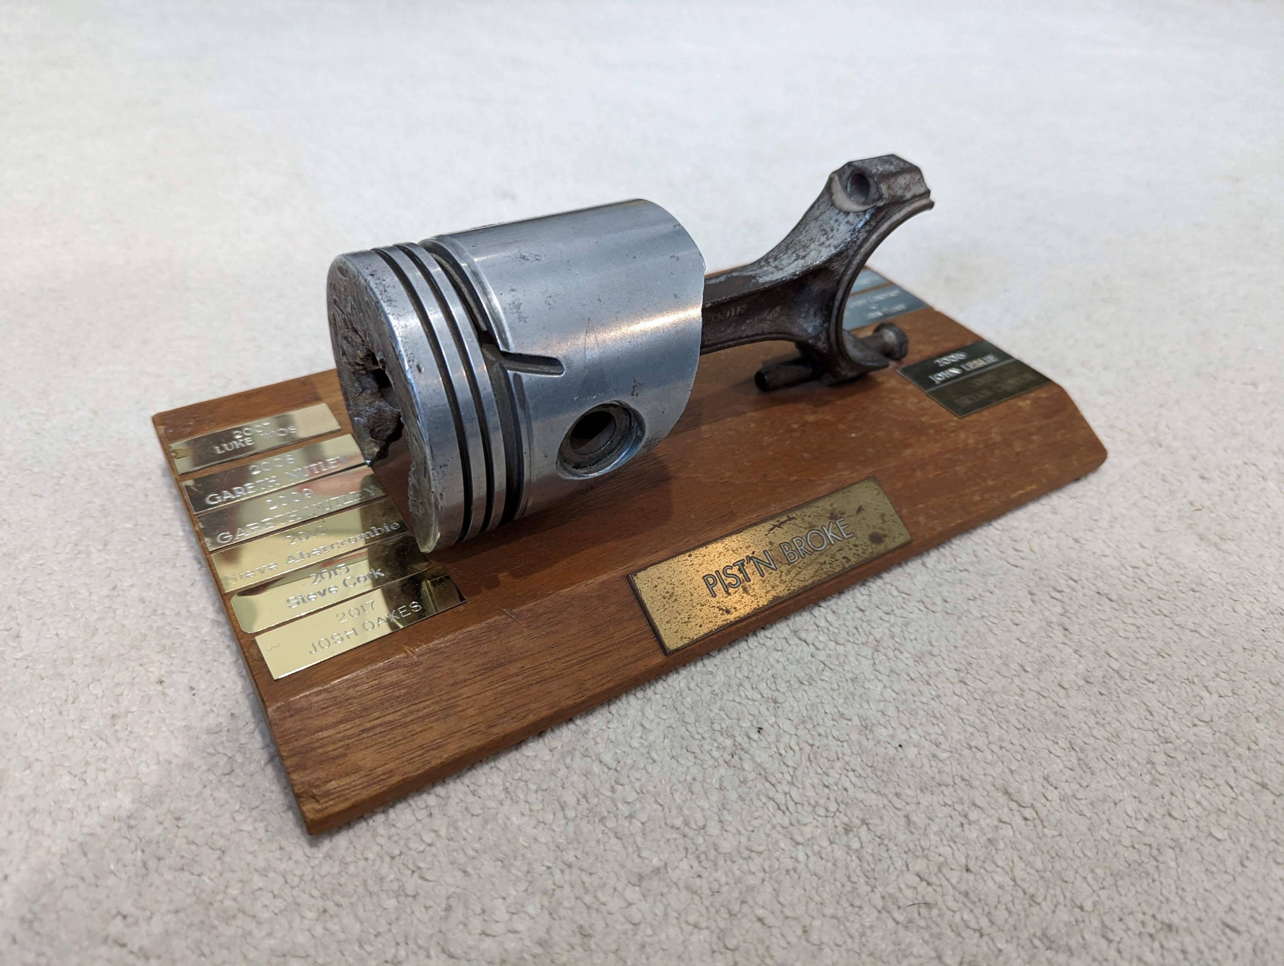
Other Awards
The Pist’n Broke Award
This is a Competitors Nomination Award for the ‘Most / Biggest Breakdowns’ suffered by a fellow competitor in the SSS Championship
Winner: Bryan Crouch
Pist’n Broke Award

